Slide 1

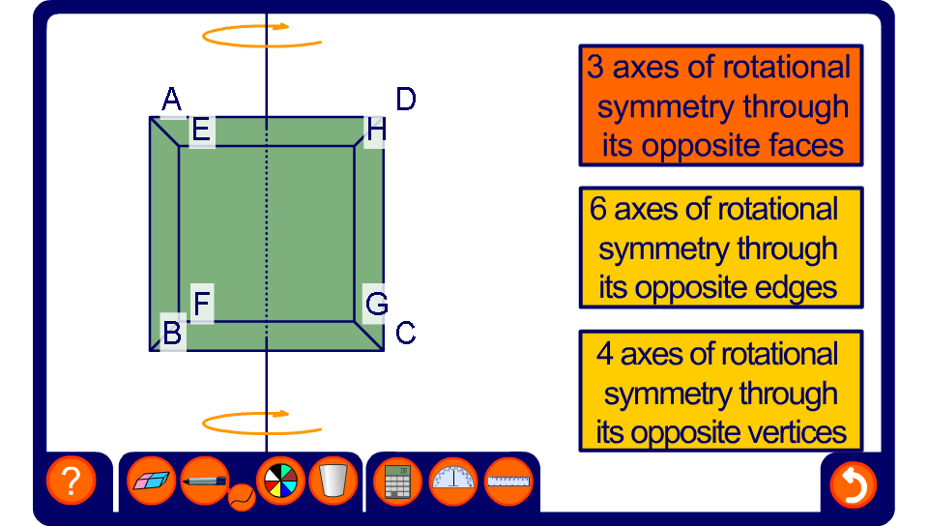


Rotational symmetry in 3-D shapes
Notes:
Use this rotating cube to establish that the order of rotational symmetry about the axes of symmetry that pass through the centre of two opposite faces is 4, the order of rotational symmetry about the axes of symmetry that pass through the centre of two opposite edges is 2 and the order of rotational symmetry about the axes of symmetry that pass through the centre of two opposite vertices is 3.

